Slide 1
AIDS-related Mycoses: Cryptococcus, Histoplasma, and other Endemic Mycoses
Andrej Spec, MD, MSCI
Washington University In St Louis School of Medicine
@FungalDoc
Share your thoughts on this presentation with #IAS2019

Slide 2
Disclosure: Andrej Spec, M.D., MSCI Date: 7/23/2019
Andrej Spec, MD, MSCI has financial interests to disclose. Potential conflicts of interest have been resolved.
Research Support / Grants
Consulting/Honoraria
NIH
Astellas
Scynexis
MiraVista
IMMY
Cidara
Amplyx
Viamet
Astellas
Minnetronix
Mayne
Scynexis

Slide 3
Methods
PubMed search in English using the MeSH database
All searches include the fungus MeSH term AND "HIV"[Mesh]
Limited to humans and last 5 years
Supplemented by searches through the top 10 general medicine and ID journals (Based on Impact Factor)
Articles selected using Altmetric score, and filtered on relevance

Slide 4
Cryptococcus

Slide 5
The Global Burden of Cryptococcus (Modeling)
Average global incidence amongst PLWH with cd4<100 cells/ml is 6%
This varies significantly between areas (~2-15%)
Global estimate is 278,000 (95% CI 195,500–340,600) infections
181,100 (95% CI 119,400–234,300) deaths
73% of cases occur in Sub-Saharan Africa
Lancet Infect Dis 2017; 17: 873–81

Slide 6
Central America left out of Model
Central America is poorly studied, possibly underrepresented
Our still unpublished data from San Pedro Sula, Honduras suggests the rate might be higher than previously thought
28/221 (12.7%) positive in San Pedro Sula
Lancet Infect Dis 2017; 17: 873–81

Slide 7
Enhanced Prophylaxis in CD4<100
Study performed in Sub-Saharan Africa, with high incidence of TB and Cryptococcus (but not histoplasmosis, which would be important in Latin America)
Enhanced prophylaxis with CD4 <100 , additional:
12 weeks of INH
12 weeks of fluconazole
5 Days of azithromycin
Resulted in Improved survival
N Engl J Med 2017;377:233-45

Slide 8
Decrease Seen in Fungal Infections and TB
N Engl J Med 2017;377:233-45

Slide 9
Mortality Benefit the Highest in Cryptococcus
N Engl J Med 2017;377:233-45

Slide 10
The Cost Effectiveness of 5FC
In Sub-Saharan Africa, mean increase in cost is $219 (US), with an 18.7% decrease in mortality
In US, cost in the last 5 years has been around $27,000 per 14-day course
FDA has approved 3 new generics in the past year, bringing down the cost 78% to $5,900 (still unreasonable)
Shiri, Clin Infec Dis, 2019
Rajasingham, Clin Infec Dis, 2019

Slide 11
Short Duration of Liposomal Amphotericin
Phase 2 RCT comparing:
L-Amb 10 mg/kg on day 1
L-Amb 10 mg/kg on day 1 and 5 mg/kg on day 3
L-Amb 10 mg/kg on day 1, and 5 mg/kg on days 3 and 7
L-Amb 3 mg/kg for 14 days
No difference in outcome (EFA)
10-week mortality 15-29% between groups
Phase 3 RCT underway
Clinical Infectious Diseases 2019;68(3):393–401

Slide 12
histoplasma

Slide 13
“Histoplasma Dethrones TB”
Lancet Infect Dis 2018; 18: 1150–59

Slide 14
Uncovering the Iceberg in Colombia
When clinicians are trained to look for histoplasmosis, there is a dramatic increase in diagnoses
Introduction of the Histoplasma antigen test by the CDC has increased diagnoses in areas 7-fold
J. Fungi 2019, 5, 51

Slide 15
The Effect of Earlier Diagnoses on Mortality in French Guiana
J. Fungi 2019, 5, 51

Slide 16
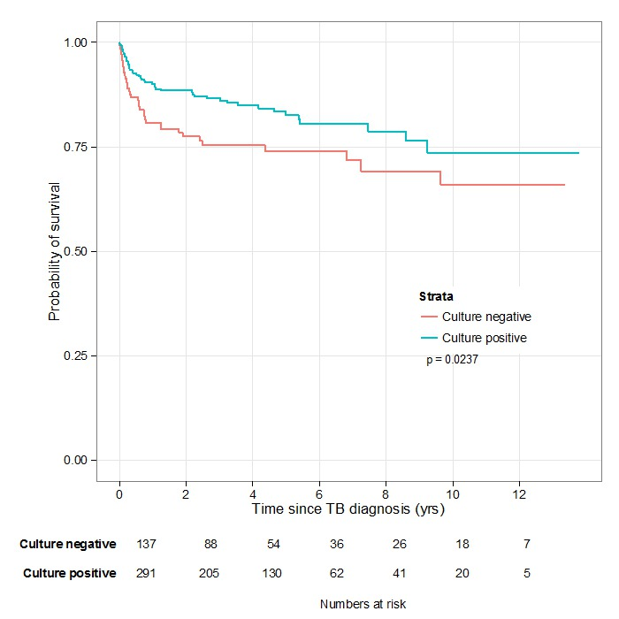
Where are the Extra Cases Coming from?
Am. J. Trop. Med. Hyg., 84(2), 2011, pp. 239–240 Sterling, CROI 2015, Abs #883

Slide 17
The Entry of Histoplasma LFA
Initial CDC testing in 2009 created a limited time antigen test that could be deployed in low to middle income countries
Spurred innovation with both MiraVista and IMMY commercial LFAs under development
Anticipated sensitivity of 80-90%
Below current EIA, but will dramatically improve current diagnostics
Awareness raising in each country still required
PLoS Negl Trop Dis. 2018 Oct; 12(10): e0006802.

Slide 18
Other endemic mycoses

Slide 19
Treatment of Talaromcyes
N Engl J Med 2017;376:2329-40.

Slide 20
Driver of Outcome is EFA
N Engl J Med 2017;376:2329-40.

Slide 21
Discovery of HIV-Related Emonsia in Italy and South Africa
Histoplasma like infection
Prominent skin findings
Described as Emonsia
No longer Emonisa
Many of the species previously called Emonisa, that cause adiospiromycosis are reclassified into Emergomyces spp.
Italian taxa (now Emergomyces pasteurianus)
S African taxa (Emergomyces africanus)
N Engl J Med 2013;369:1416-24.

Slide 22
Summary
Cryptococcus and Histoplasma have high incidence
Incidence is likely underappreciated
Often misdiagnosed as TB or HIV-wasting
Amphotericin still appears to be the most effective antifungal
Novel strategies for dosing may overcome cost barriers
5FC is cost effective and the price is coming down
Enhanced prophylaxis for people diagnosed with advanced disease

Slide 23
Thank you for your time
@FungalDoc

